Slide 1

SwItched Lan’S
Switched Local Area Networks

Slide 2
WHAT IS A SWITCH?
A typical network consists of nodes(computers), connecting medium(wired or wireless),specialized network equipment like routers or hubs.
Switches are another fundamental part of networks because switches speed up the process.
Switches allow different nodes(a network connection point, typically a computer) of a network to communicate directly with one another.

Slide 3
Why swItchIng?
As network grows,there are some potential problems with networks consisting of nodes connected with hubs:
Scalability: In a hub network limited shared bandwith makes it difficult to accomodate signifcant growth without sacrificing performance.
Latency: Each node in a hub based network has to wait to transmit in order to avoid collisions, the latency can increase significantly as you add more nodes.

Slide 4
Why SwItchIng?
Network Failure: In a typical network, one device on a hub can cause problems for other devices attached to the hub due to incorrect speed settings(100 Mps on a 10 Mpbs hub).
Collisions: A network with a large number of nodes on the same segent will ofthen have a lot of collisions.
While hubs provide an easy way to scale up and shorten the distance, hubs do not break up actual network into discrete segments. That is where switches are needed.

Slide 5
Why SwItchIng?
The difference between a hub and a switch is that all the nodes connected to a hub share the bandwidth among themselves, while a device connected to a switch port has the full bandwidth all to itself.
For example, if 10 nodes are communicating using a hub on a 10-Mbps network, then each node may only get a portion of the 10 Mbps if other nodes on the hub want to communicate as well. But with a switch, each node could possibly communicate at the full 10 Mbps.

Slide 6

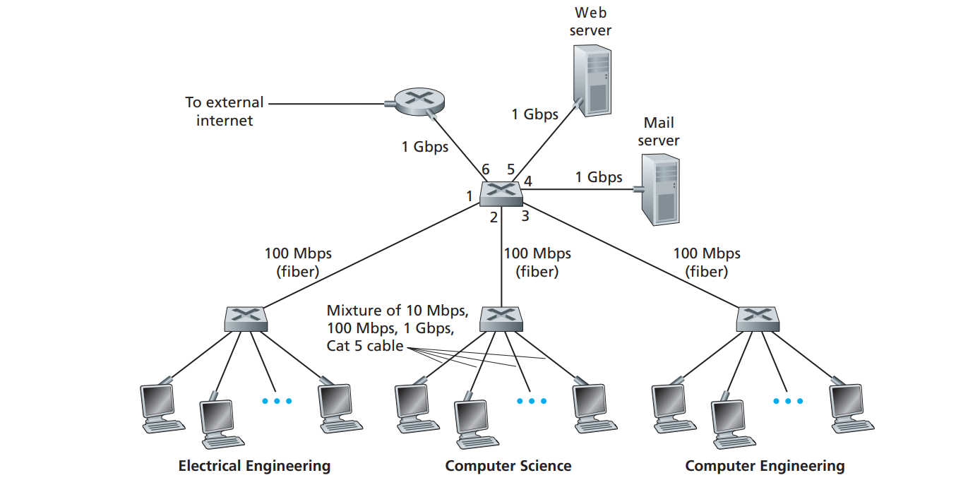
An institutional network connected by four switches
The Figure shows a switched local network connecting three departments, two servers and a router with four switches.
Figure 1- Example to a switch [1]

Slide 7
LAN SWITCHES
There are many different types of switches and networks.
Switches that provide a separate connection for each node in a company’s internal network are called LAN switches.
Local Area Network(LAN) is a network of computers that are in the same general physical location(like a building or campus). If the computers are far apart(like different cities) then Wide Area Network(WAN) is typically used.
Essentailly, a LAN switch creates a series of instant networks that contain only the two devices communicating with each other at that particular moment.

Slide 8
Fully SwItched Networks
In a fully switched network, switches replace all the hubs of an Ethernet network with a dedicated segment for every node.
These segments connect to a switch, which supports multiple dedicated segments (sometimes hundreds).
Since the only devices on each segment are the switch and the node, the switch picks up every transmission before it reaches another node. The switch then forwards the frame over the appropriate segment.
Since any segment contains only a single node, the frame only reaches the intended recipient. This allows many conversations to occur simultaneously on a switched network.

Slide 9
Fully SwItched Networks
Switching allows on a network to maintain full-duplex which means, each node communicates only with the switch, not directly with other nodes. Information can travel from node to switch and from switch to node simultaneously. Therefore it is a collision free environment.
Transmitting in both directions can effectively double the apparent speed of the network when two nodes are exchanging information. If the speed of the network is 10 Mbps, then each node can transmit simultaneously at 10 Mbps.

Slide 10
MIxed Networks
Most networks are not fully switched because of the costs incurred in replacing all the hubs with switches.
Instead, a combination of switches and hubs are used to create an efficient yet cost-effective network. For example, a company may have hubs connecting the computers in each department and then a switch connecting all the department-level hubs.

Slide 11
Routers vs SwItches
Switches usually work at Layer 2 (Datalink layer) of the OSI Reference Model, using MAC addresses. Routers work at Layer 3 (Network layer) with Layer 3 addresses like IP.
The algorithm that switches use to decide how to forward packets is different from the algorithms used by routers to forward packets.
One of these differences in the algorithms between switches and routers is how broadcasts are handled. Broadcast packet concept is vital for networks operability.
Broadcasts are used any time a device needs to make an announcement to the rest of the network or is unsure of who the recipient of the information should be. Whenever a device needs to send out information but doesn't know who it should send it to, it sends out a broadcast.

Slide 12
Packet-SwItchıng
LAN switches rely on packet-switching.
Packet switching is a method of grouping data that is trasmitted over a digital network into packets. Packet switching is the primary basis for data communications in computer networks worldwide.
The switch establishes a connection between two segments just long enough to send the current packet.
Packets are made of header and payload.
Data in the header is used by networking hardware to direct packet to its destination, where the payload is extracted and used by application software.
Packet based switches use on of the three methods for routing traffic: Cut-through, store-and-forward, fragment-free.

Slide 13
Packet Based SwItches
Cut-through switches read the MAC address as soon as a packet is detected by switch. After storing the 6 bytes that make up the address information they immediately begin sending packet to its destinatination node even as the rest of the packet is coming into the switch.
Store-and-forward will save the entire packet to the buffer and check it for errors before sending. If there is no error switch looks up the MAC address and sends the packet on to the destination node.
Many switches use cut-through until a certain error level, then chang over to store-and-forward.
Fragment-free is a less common method that works like cut-through except that stores the first 64 bytes of packet before sending. The reason is most errors occur at the initial 64 bytes of a packet.

Slide 14
SwItch ConfIguratIons
LAN switches vary in their physical design. Currently there are three popular configurations in use:
Shared memory: These switches stores all incoming packets in a common memory buffer shared by all the switch ports(I/O connections), then sends them out via the correct port for the destination node.
Matrix: These switches have an internal grid(table) with the input ports and the output ports crossing each other. When a packet is detected on an input port the MAC address is compared to the lookup table to find appropriate output port.
Bus architecture: An internal trasmission path(common bus) is shared by all of the ports using TDMA(time division multiple access). These switches have a dedicated memory buffer for each porrt as well as an ASIC(application specific integrated circuit) to control the internal bus access.

Slide 15
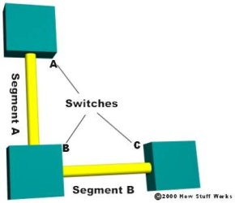
SwItches and segments
On the left you can see A,B,C switches and segment A and segment B between them.
Segments are the parts between the switches.
Figure 2- Example to switches and segments [2]

Slide 16
Transparent BrIdgIng
Most ethernet LAN switches use a system called transparent bridging to create their address lookup tables.
Transparent bridging is a technology that allows a switch to learn everything it needs to know about the location of nodes on the network without the network admin having to do anything.
Transparent bridging is essentially maintenance-free way to add and manage all the information a switch needs to do its job.
Transparent bridging has five parts: Learning, flooding,filtering,forwarding,aging.

Slide 17
TRANSPARENT BRIDGING PROCESS
Transparent bridging process:
The switch is added to network and various segments are plugged into the switch’s ports.
A computer(node A) on the first segment(segment A) sends data to a computer(node B) on another segment(segment C).
Learning: The switch gets the first packet of data from Node A, it reads the MAC address and saves it to the lookup table for Segment A. Swtich now knows where to find Node A anytime a packet is addressed to it.
Flooding: Since the switch does not know where Node B is , it sends the packet to all of the segments except the one that it arrived on (Segment A). When a switch sends a packet out to all segments to find a specific node, it is called flooding.

Slide 18
Transparent BrIdgIng Process
Forwarding: The packet from Node B arrives at the switch. Now the switch can add the MAC address of Node B to the lookup table for Segment C. Since the switch already knows the address of Node A, it sends the packet directly to it. Because node A is on different segment than Node B, the switch must connect the two segments to send the packet, this process is known as forwarding. The next packet from Node A to Node B arrives at the switch. The switch now has the address of Node B, too so it forwards the packet directly to Node B.

Slide 19
Transparent BrIdgIng Process
Filtering: Node C sends information to the switch for Node A. The switch looks at the MAC address for Node C and adds it to the lookup table for Segment A. The switch already has the address for Node A and determines that both nodes are on the same segment, so it does not need to connect Segment A to another segment for the data to travel from Node C to Node A. Therefore the switch will ignore packets traveling between nodes on the same segment, this process is called filtering.

Slide 20
Transparent brIdgIng process
Aging: Learning and flooding continue as the switch adds nodes to the lookup tables. Switches optimize the use of their memory, they remove older information by using aging technique. When an entry is added to the lookup table for a node, it is given a timestamp. Each time a packet is received from a node the timestamp is updated. The switch has a user configurable timer that erases the entry after a certain amount of time with no activity from that node. This frees up valuable memory resource for other entries.

Slide 21
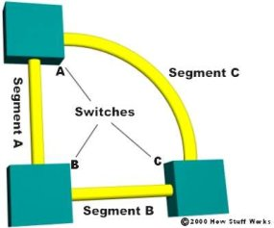
Redundancy In lan swıtchıng
In Figure 2, if the switch B fails the entire network is brought down.
Therefore in Figure 3 we connect the Switch A with Switch C with a new Segment C. This provides redundancy effectively eliminating the single point of failure.
But now, we have a new problem.
Figure 2- Example to switches and segments [2]
Figure 3 - Example to a redundant network [2]

Slide 22
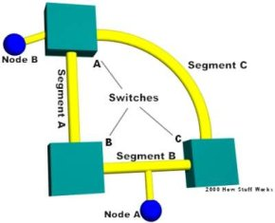
BROADCAST STORMS
We will learn how switches learn where the nodes are located. In Figure 4, with all of the switches now connected in a loop, a packet from a node could quite possibly come to a switch from two different segments.
Let say we have a packet. Because that the switches do not know who Node A is, switches will receive the packet from each segment and flood it back out on the other segment.
This causes broadcast storm as the packets are broadcast, received and rebroadcast by each switch resulting in potentially severe network congestin. Which brings us to spanning trees.
Figure 4- Example to broadcast storms [2]

Slide 23
SPANNING TREES
To prevent broadcast storms and other unwanted side effects of looping, Digital Equioment Corporation creaed the STP(spanning-tree protocol), which has been standardized as the 802.1d specification by the IEEE.
A spanning tree uses STA (spanning-tree algorithm), which senses that the switch has more than one way to communicate with a node, determines the best way, blocks out other paths while keeping track of them just in case the primary path is unavailable.

Slide 24
References
[1]Computer Networking a Top Down Approach Book
[2]Jeff Tyson.(viewing:2021.March.8).Lan Switch.
[computer.howstuffworks.com/lan-switch.htm]
[3]Wikipedia Contributers.(2021,March,19).Packet Switching
[https://en.wikipedia.org/wiki/Packet_switching]

